Slide 1
Effects of COVID on Retail
Raymond chen, Julius giron, schyuler Lujan, john nguyen, Elizabeth tran

Slide 2
Purpose of Analysis
Question 1: How has COVID affected the health of the retail industry?
Question 2: How has retail fared relative to other industries?
Question 3: What has changed about who is working and earning money?

Slide 3
Process of Analysis
Explore data related to retail, employment, and COVID
Perform regression analysis on data
Test models for fit and significance
Deliver analysis

Slide 4
The Data
Data was provided by IPUMS’ Current Population Survey
Employment statistics were chosen because they are a better indicator of the health of the retail industry
Timeline: January 1, 2019 to December 31, 2020
March 2020: NAs in WTFINL
Industries: Retail, Manufacturing, Information, Arts, Leisure & Hospitality

Slide 5
Impact to retail industry
How has COVID affected the health of the retail industry, as measured by employment?

Slide 6
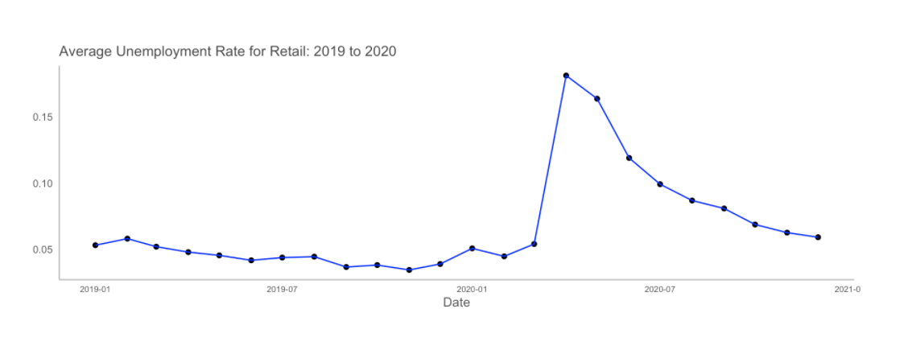
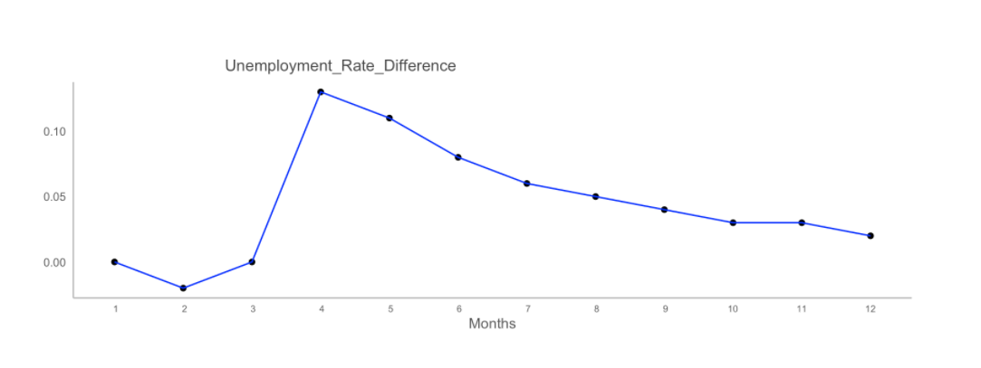
Unemployment
Unemployment spiked in April 2020
Steady decrease throughout the year
Year-end unemployment less severe
Overall, still higher than 2019 rates

Slide 7
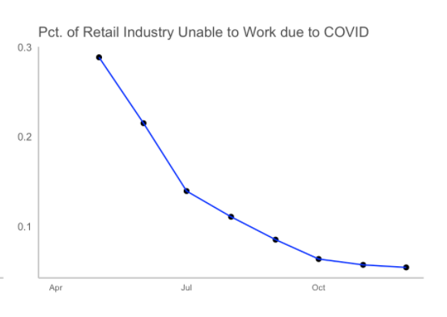
Unable to Work
High proportion of industry unable to work early in the year
Decreased sharply to much lower proportions by year-end
Indicates recovery after the severity of earlier in the year

Slide 8
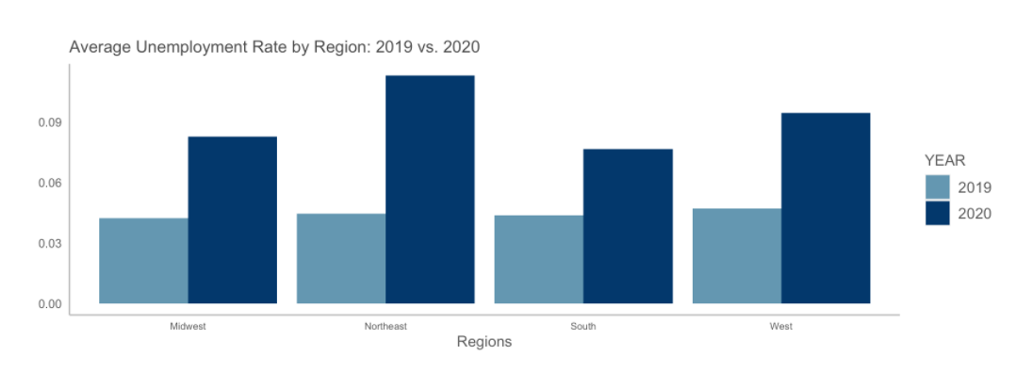
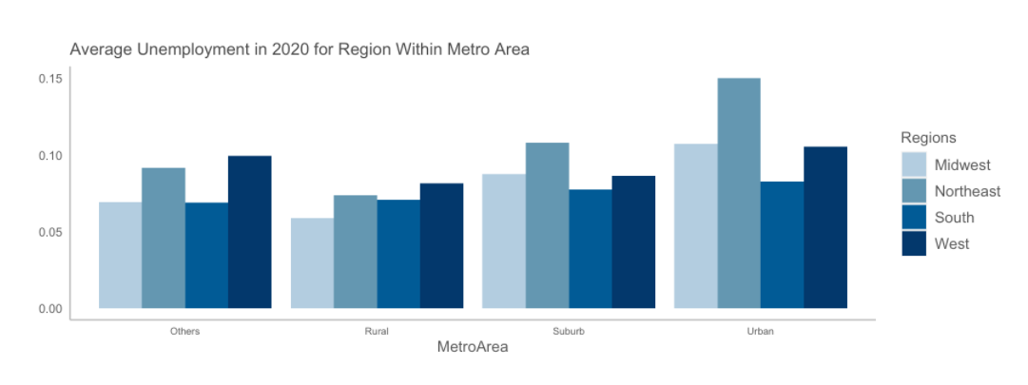
Geography
All regions show higher overall average unemployment rates in 2020
Northeast had highest difference
Urban areas were hit hard, especially in the Northeast

Slide 9
Models
Model 1
Model 2
${Employed}_{i}= β_{0}+β_{1}{Regions}_{i}+ {β_{2}MetroArea}_{i}$
${Employed}_{i}= β_{0}+β_{1}{Regions}_{i}+β_{2}{MetroArea}_{i}+β_{3}{MONTH}_{i}+{β_{4}COVIDUnableToWork}_{i}$

Slide 10
Summary of Findings
The impact to employment in the retail industry was more severe at the beginning of 2020
Industry has rebounded by the end of 2020
Decrease in average unemployment rates in the last half of 2020
Higher probability of being employed June 2020 – December 2020 relative to May 2020
Decrease in the proportion of the industry unable to work due to COVID
Negative impacts are higher in the Northeast and Urban areas
Although the industry has rebounded, it is still slightly worse off than in 2019
December 2020 average unemployment was 6% vs. December 2019 at 4%

Slide 11
Retail vs. Other Industries
How has retail fared relative to other industries?

Slide 12
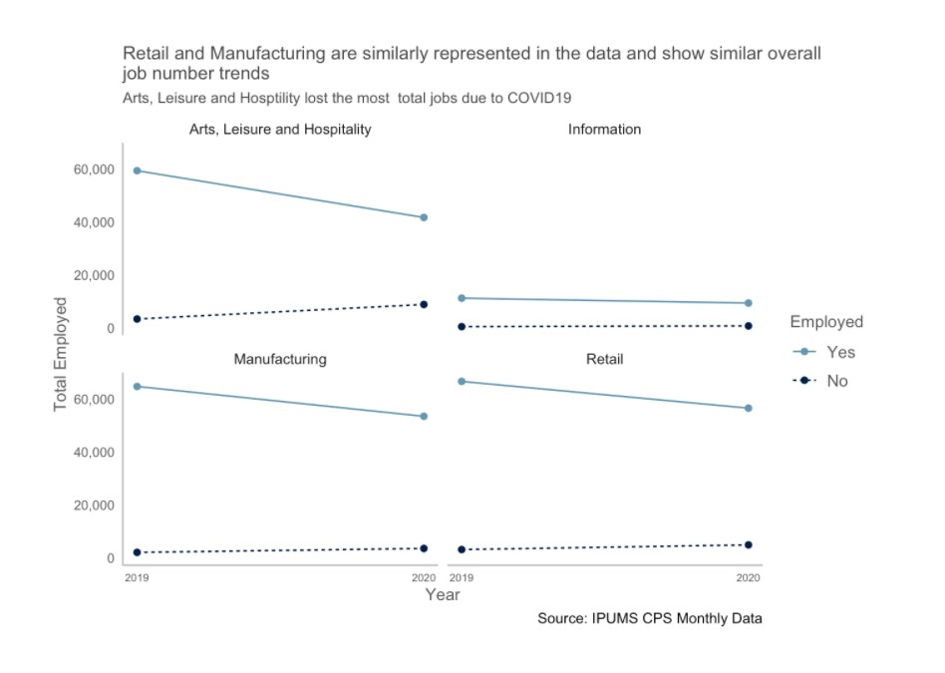
Job Trends
Assessed total employment by industry
All industries show a decrease between 2019 and 2020
Highest impact on Arts, Leisure and Hospitality
Lowest impact to Information

Slide 13
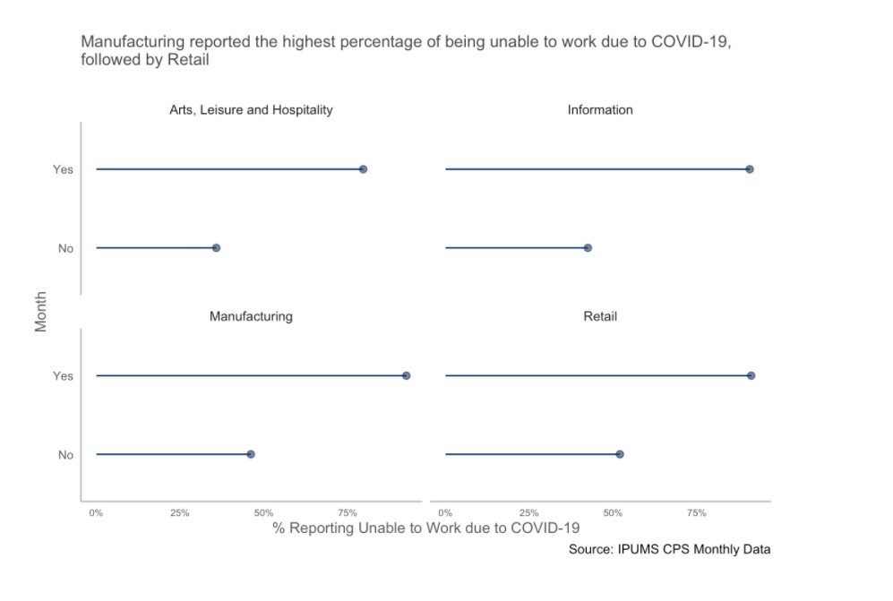
Unable to Work
Retail has highest percentage unable to work
Information industry has lowest percentage
Notes:
Retail reported the highest percentage of being unable to work due to COVID-19 .
The percentage of persons responding ‘no’ to being unable to work due to the pandemic was lowest in the Information Industry

Slide 14
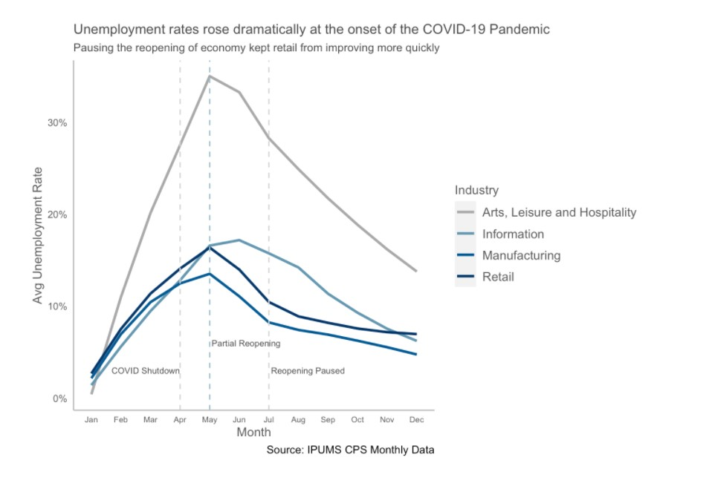
Unemployment
Arts, Leisure and Hospitality suffered most
Retail suffered more than information
April and July are critical months in 2020
Interaction between month and industry
Notes:
Comparing Retail to Arts, Leisure and Entertainment:
There’s a 10 percentage points higher probability of being employed in 2020
Comparing Retail to being in Manufacturing or Information:
There’s a higher probability of being employed by 2 and 1 percentage points, respectively
April and July were two critical months in 2020 that pointed at increased unemployment rates due to either States shutting down or pausing their reopening
The probability of being employed decreases by 32 percentage points in April and by 18 percentage points in July, within the reference industry, Arts, Leisure and Entertainment.
In July, being employed in Retail results in a 5-percentage point higher probability of being employed when compared to the Information industry and a 13-percentage point higher probability when compared to Arts, Leisure and Hospitality.

Slide 15
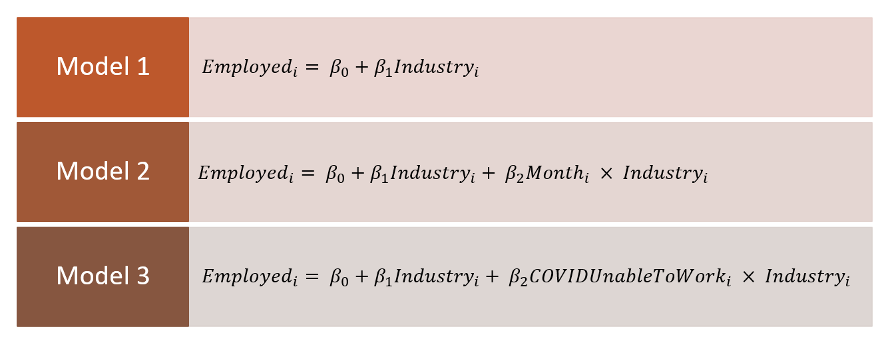
Models
Model 1
Model 2
Model 3
${Employed}_{i}= β_{0}+β_{1}{Industry}_{i}+ β_{2}{COVIDUnableToWork}_{i} × {Industry}_{i}$
〖𝐸𝑚𝑝𝑙𝑜𝑦𝑒𝑑〗_𝑖= 𝛽_0+𝛽_1 〖𝐼𝑛𝑑𝑢𝑠𝑡𝑟𝑦〗_𝑖+ 𝛽_2 〖𝐶𝑂𝑉𝐼𝐷𝑈𝑛𝑎𝑏𝑙𝑒𝑇𝑜𝑊𝑜𝑟𝑘〗_𝑖 × 〖𝐼𝑛𝑑𝑢𝑠𝑡𝑟𝑦〗_𝑖
${Employed}_{i}= β_{0}+β_{1}{Industry}_{i}$
〖𝐸𝑚𝑝𝑙𝑜𝑦𝑒𝑑〗_𝑖= 𝛽_0+𝛽_1 〖𝐼𝑛𝑑𝑢𝑠𝑡𝑟𝑦〗_𝑖
${Employed}_{i}= β_{0}+β_{1}{Industry}_{i}+ β_{2}{Month}_{i} × {Industry}_{i}$
Notes:
Model 1: As a baseline, we run a model looking solely at the effect the type of industry has on the probability being employed.
Model 2: Our second model looks at the effect of month on the industries, particularly the months associated with the initial COVID-19 shutdown (April), the second shutdown (July), and the peak Retail season of November and December.
Model 3: The third model measures the effect of the interaction between Industry and COVIDUnableToWork and its effect on the probability of being employed.
Results: Interactions between month and industry and COVIDUnableToWork and Industry yielded statistically significant results.

Slide 16
Summary of Key Findings
With all other variables held constant, when we compare Retail to Arts, Leisure and Entertainment there is a 10-percentage point higher probability of being employed in 2020, while we are in the COVID-19 pandemic
April and July were two critical months in 2020 that pointed to increased unemployment rates due to either States shutting down or pausing their reopening
Being unable to work due to business closures from COVID-19 and being in the Retail industry has a 5-percentage points higher probability of being employed when compared to the Information industry and a 6-percentage points advantage over the probability of being employed in the Arts, Leisure and Hospitality industry

Slide 17
Who has money to spend?
What has changed about who is working and earning money?

Slide 18
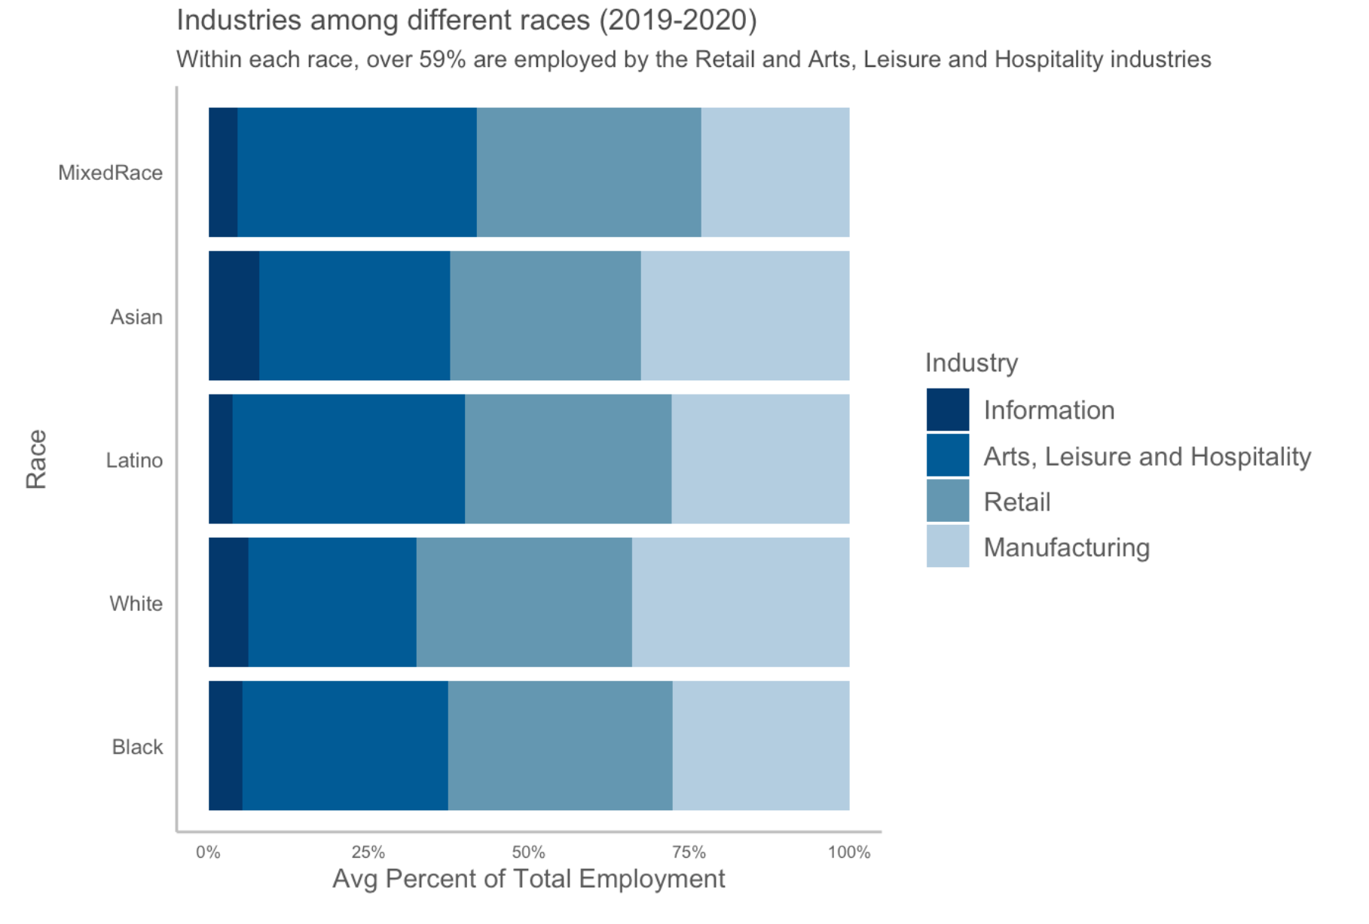
Race
Majority worked in Retail and Arts, Leisure and Hospitality
A smaller percent worked in Information

Slide 19
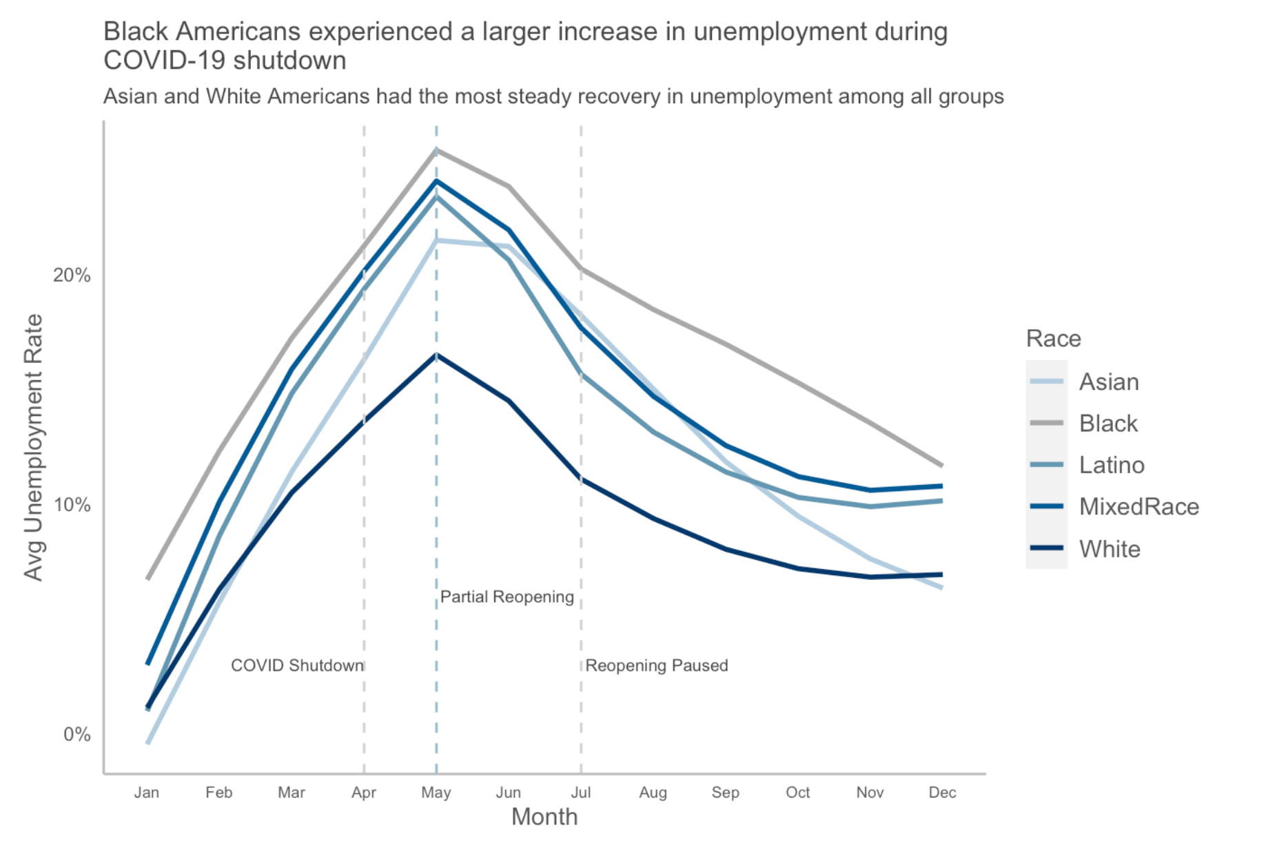
Race
Highest unemployment among Black Americans
Steady recovery for Asian and White Americans
Unemployment remained higher for other Minority Americans

Slide 20
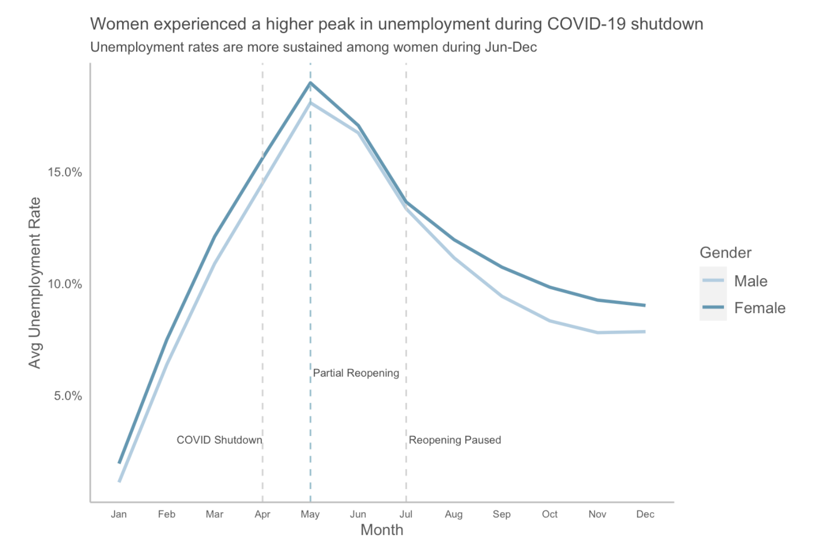
Gender
Majority of women worked in Retail or Arts, Leisure and Hospitality
Women experienced more unemployment
Retail employed more men, but women suffered higher unemployment

Slide 21
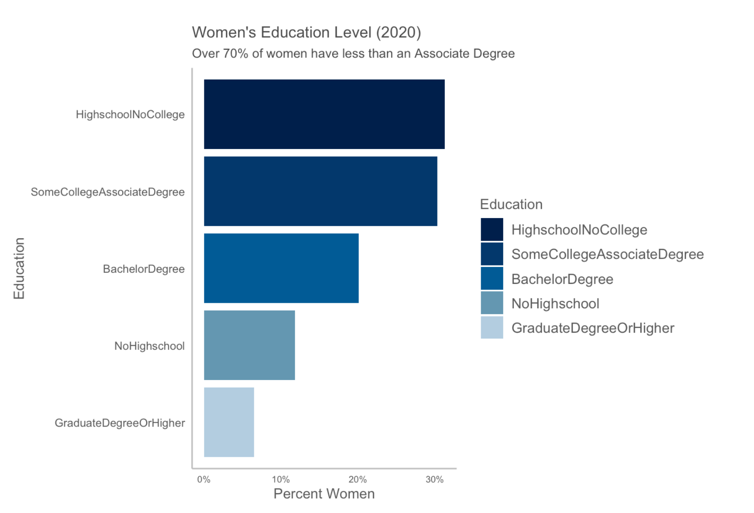
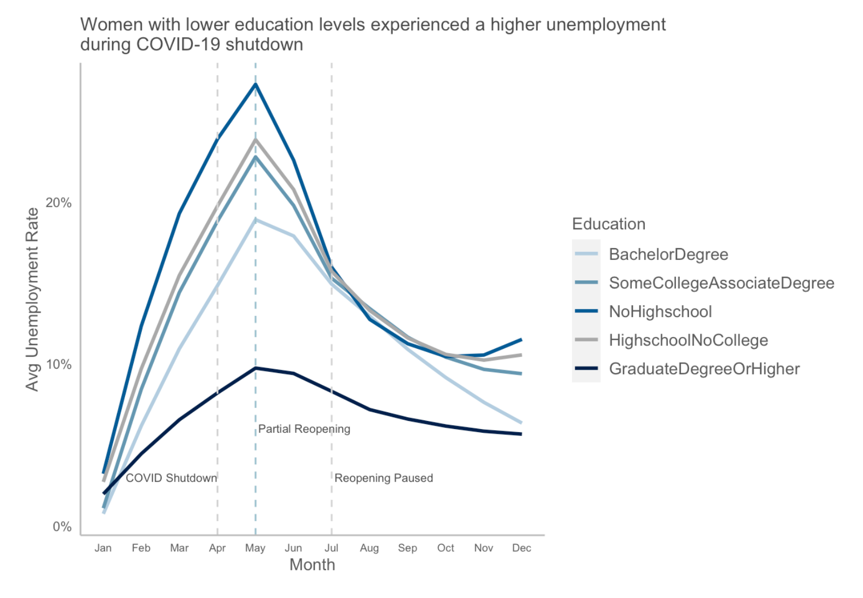
Women’s Education

Slide 22
Models
Model 1
Model 2
Model 3
${Employed}_{i}= β_{0}+β_{1}{Gender}_{i} × {Race}_{i}$
${Employed}_{i}= β_{0}+β_{1}{Gender}_{i}× {Age}_{i}$
${Employed}_{i}= β_{0}+β_{1}{Gender}_{i}× {Education}_{i}$

Slide 23
Assumption
Individuals with a higher probability of being employed are more likely to work during the COVID-19 pandemic
Individuals working during the COVID-19 shutdown have more spending power than those unable to work.

Slide 24
Who Has Money to Spend
Highest Spending Power
Lowest Spending Power
Those with graduate or higher education
Men between the age of 50 and 59
White American men
Women without college education
Single moms between the age of 20 and 29
Black American women

Slide 25
Conclusions
Question 1: How has COVID affected the health of the retail industry?
The retail industry was severely impacted early in 2020 and rebounded by year-end
Although it rebounded, the retail industry is still worse off in 2020 than in 2019
Question 2: How has retail fared relative to other industries?
Arts, Leisure and Hospitality was hit hardest
When we compare Retail to Arts, Leisure and Entertainment there is a 10-percentage point higher probability of being employed in 2020
Being unable to work due to business closures from COVID-19 and being in the Retail industry has a 5-percentage points higher probability of being employed when compared to the Information industry and a 6-percentage points advantage over the probability of being employed in the Arts, Leisure and Hospitality industry
Question 3: What has changed about who is working and earning money?
Highest spending power includes those with graduate degrees or higher
Men between the ages of 50 and 59
White males

Slide 26
Thank-you
Please contact us with any questions

